Slide 1


DE2: SAT-based Sequential Logic Decryption with a Functional Description
You Li*, Guannan Zhao*, Yunqi He and Hai Zhou
Northwestern University, USA
*Equal Contribution
Notes:
Hi, in this talk, we will present D-E-square, a new attack against logic locking. DE2 can be applied to the scenario that the adversary cannot access to either the scan chain or a working oracle circuit.
https://www.date-conference.com/programme

Slide 2
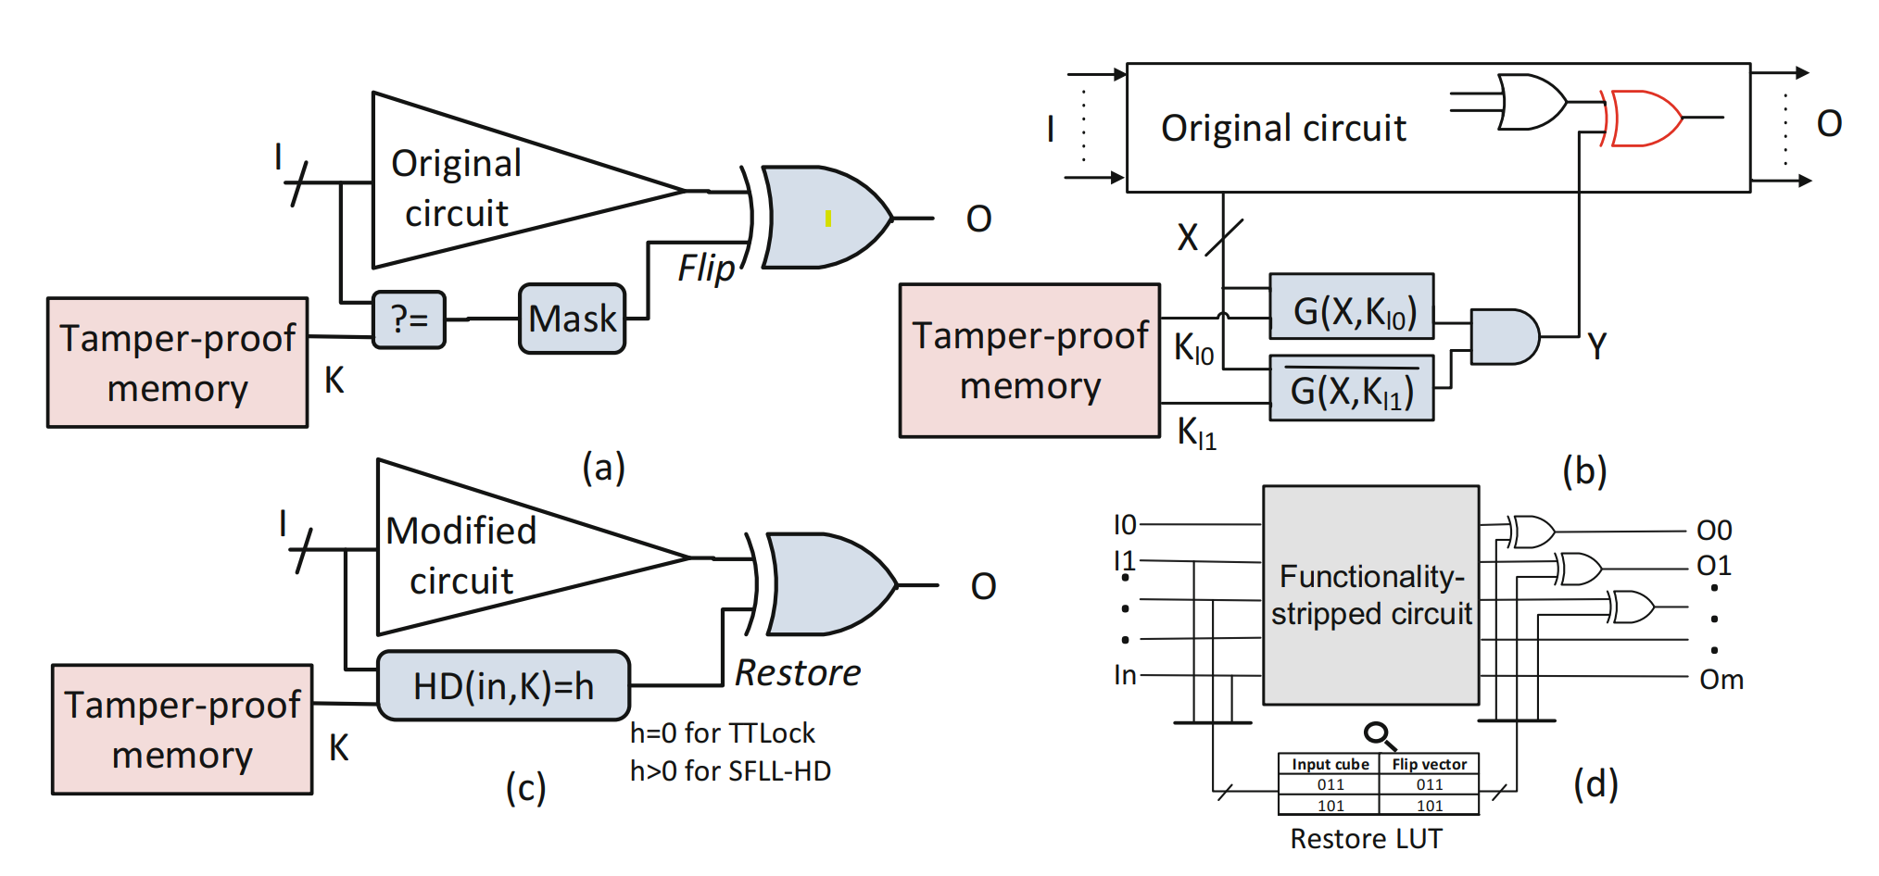
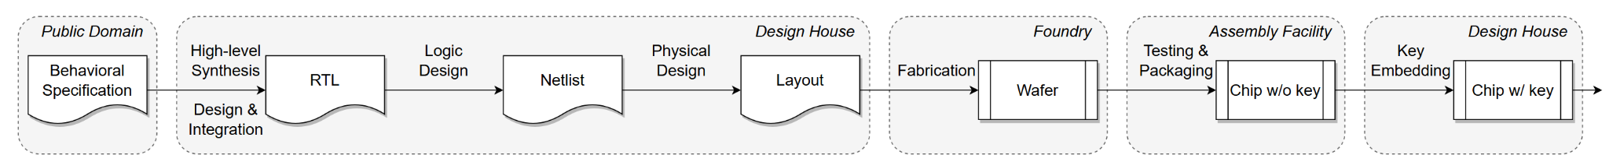
Logic Locking
Logic locking is a technique that can protect the intellectual property and enhance the security of ICs.
It embeds binary key bits into the netlist or the layout of a circuit. Without knowing the correct key, an adversary cannot recover the functionality of the original circuit.
Notes:
Logic locking is a prominent approach to safeguard the intellectual property and protect the security of hardware designs. The design house embeds key-controlled locking units into the netlist or the layouts of the circuit. The correct key is inserted into the circuit only when the chips are returned from the foundry. Without knowing the correct key, malicious parties within the supply chain or malicious end-users cannot recover the functionality of the circuit.

Slide 3
Functional Attack against Logic Locking
The original SAT-based attack requires
  1. scan-chain access to the locked circuit, and
  2. query access to an activated oracle circuit.
In each iteration, a new input-output pair is added as a constraint to the SAT solver. Each constraint eliminates some incorrect key patterns.
When scan-chain access is not available, an adversary can unroll the locked circuit to launch a sequential logic decryption.
Notes:
The SAT-based attack is a powerful functional attack against logic locking. The original SAT-based attack requires scan-chain access to the locked circuit and query access to an activated circuit. In each iteration, it queries the oracle circuit with a new input pattern, and collect the corresponding output pattern. This new input/output pair is added as a new constraint to the locked circuit to eliminate incorrect key patterns. It uses a SAT solver to extract a correct key when all incorrect ones are eliminated.
When scan-chain access is not available, the SAT-based attack needs to unroll the locked circuit and query the oracle circuit across multiple clock cycles. This is called a sequential logic decryption.

Slide 4
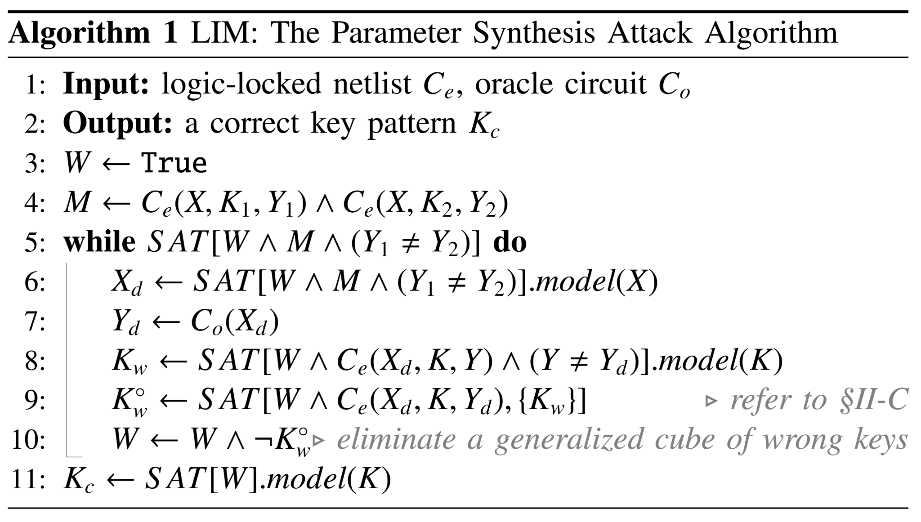
Logic Decryption with Parameter Synthesis
We leverage parameter synthesis to reduce the number of clauses introduced by each new constraint.
  Instead of duplicating the whole locked circuit, our approach distills a subset of incorrect key patterns, which can be represented by a small set of clauses.
Notes:
We leverage parameter synthesis to reduce the burden on the SAT solver. Instead of duplicating the whole locked circuit and eliminate all key patterns that violate a given input-output pair, our approach distills a subset of incorrect key patterns from that condition. Essentially, we trade of the number of incorrect key patterns eliminated in every iteration for a significantly more concise representation of the constraint.
In each iteration, our approach first finds a new incorrect key pattern. Afterward, it utilizes an unsat-core query to extract a set of irreducible prime implicants from the current constraint and all the previous constraints. The extracted clauses are added as the new constraint into the SAT solver.

Slide 5
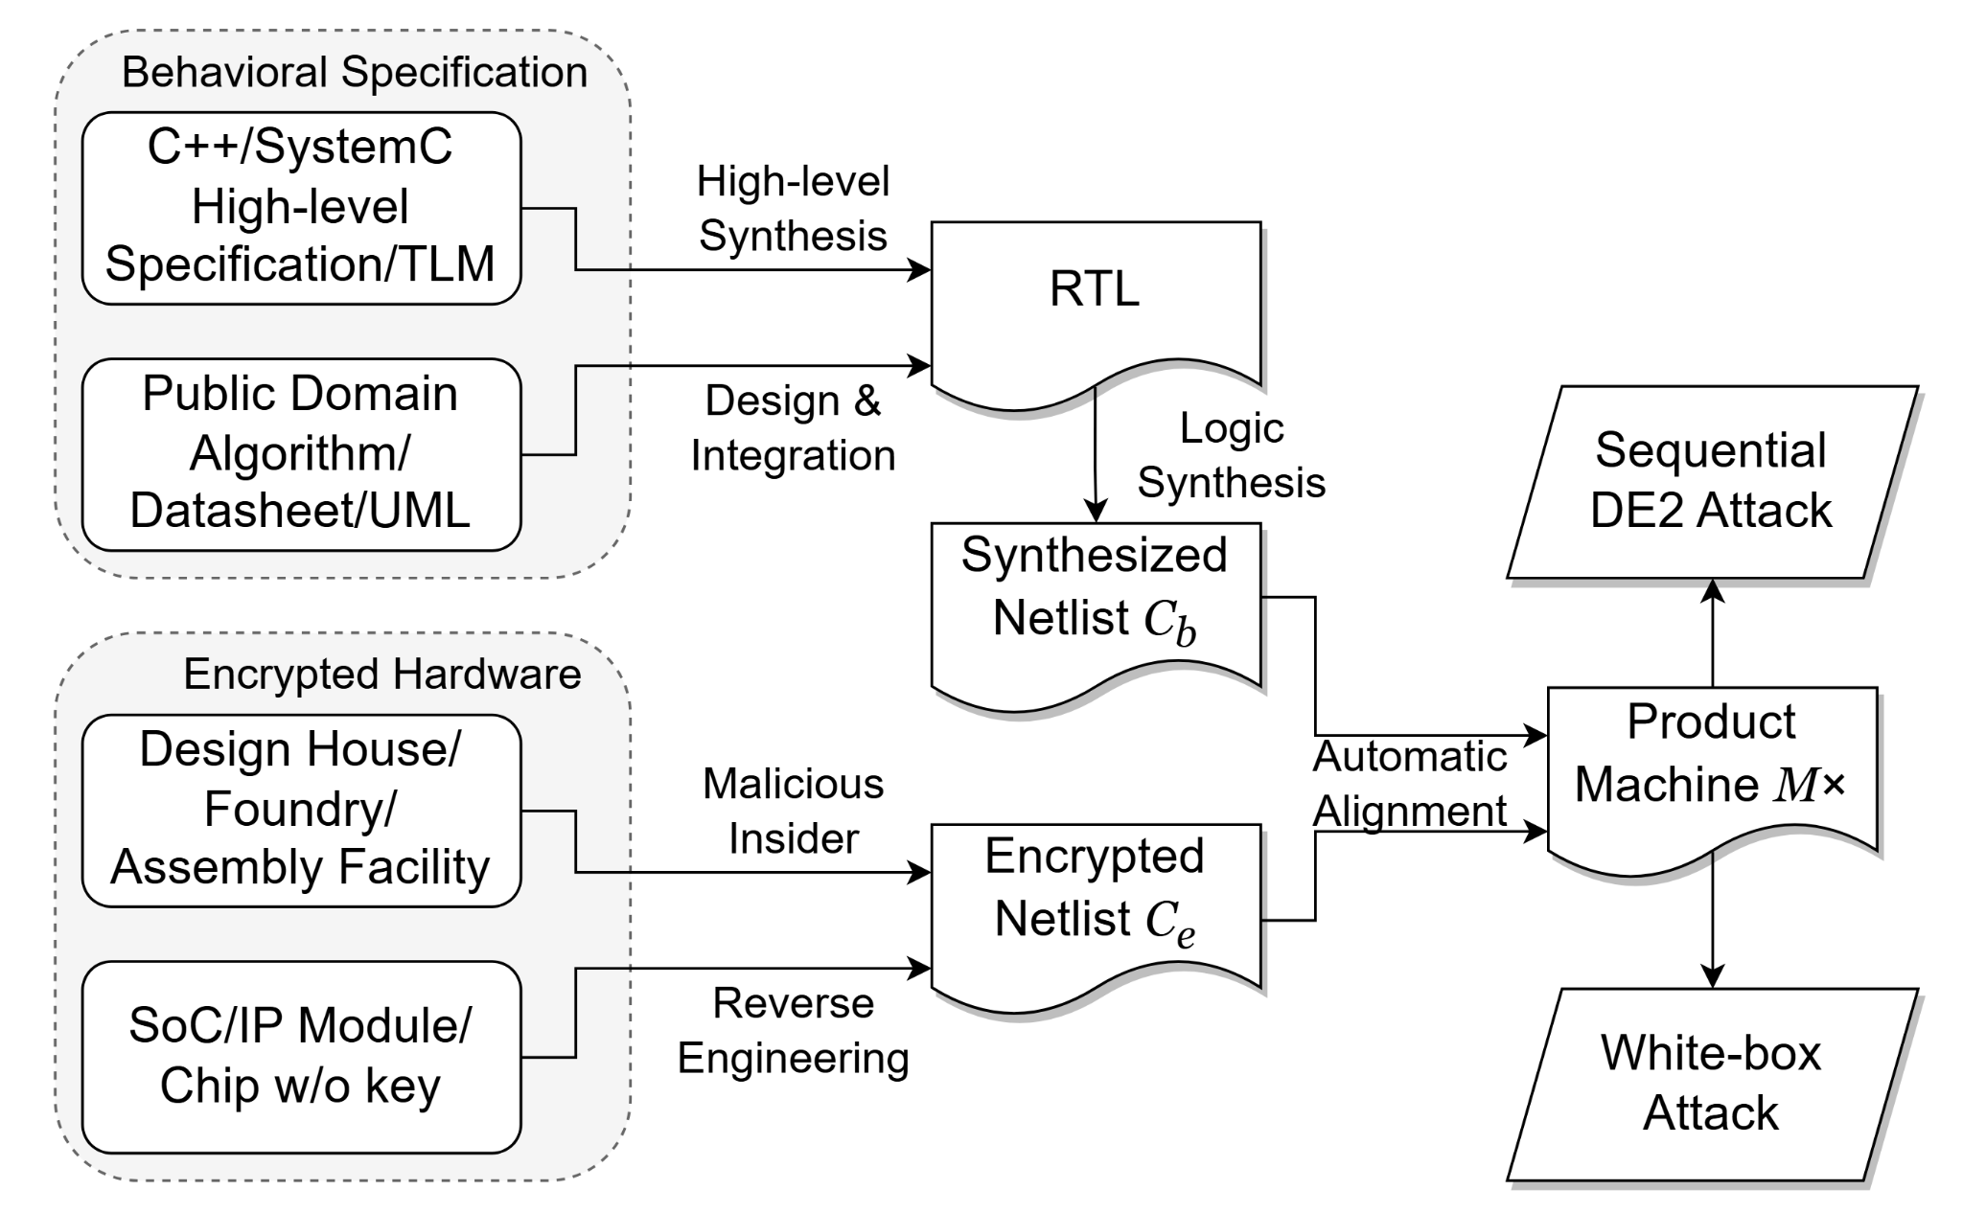
Functional Description as the Oracle
An activated oracle circuit is not always available to the adversary.
DE2 automatically align the functional description with the encrypted circuit on-the-fly during decryption.
Notes:
An activated oracle circuit is not always available to the adversary. For example, a chip designed for critical missions or for customized applications may not be available on the open market; it may be too late to start reverse engineering after the targeted chip is on the market, because the market opportunity may have already expired; the activated circuit may contain a large number of modules, whereas the adversary only has the resources to attack one of them.
DE2 takes a system-level or behavioral-level model of the circuit to launch the attack. Such a model can be obtained in different ways. For example, it can be constructed from the high-level design specification or the executable reference model used in the design house. Such models are usually distributed among the design house, IP vendors, EDA vendors and chip customers to drive the design process.
Furthermore, IP vendors and verification service providers can offer transaction-level models (TLMs) and instruction-level abstraction models (ILAs) to facilitate the integration and verification of complex systems.
This flowchart presents the general workflow of the DE2 attack. It begins with the adversary obtaining a functional description of the circuit. This functional specification is then turned into RTL using high-level synthesis tools, followed by logic synthesis to generate the synthesized netlist.
On the other side, the attacker obtains the encrypted netlist, which may be acquired through malicious insiders in design houses or foundries, or via reverse engineering from a fabricated chip without access to its decryption key.
One of the biggest limitations of prior attacks was the need for a cycle-accurate oracle. DE2 removes this requirement by introducing automatic alignment—it dynamically synchronizes the locked circuit’s execution with a functional description. This allows us to launch sequential attacks even when the timing behavior of the reference model is not precise.

Slide 6
Thank you!
Notes:
That is all for our presentation and thank you for your attention!

